Slide 1
Writing Memos and Emails

Slide 2
The Importance of Memos, Letters, Emails and Instant Messages/Text Messages
Increasing need of quick and efficient ways of correspondence
You can routinely expect to write email messages, letters, memos and reports on the job.

Slide 3
Communication Channels vary depending upon the situation
Your audience (internal or external)
The complexity of your topic
The speed of message delivery
Security concerns

Slide 4
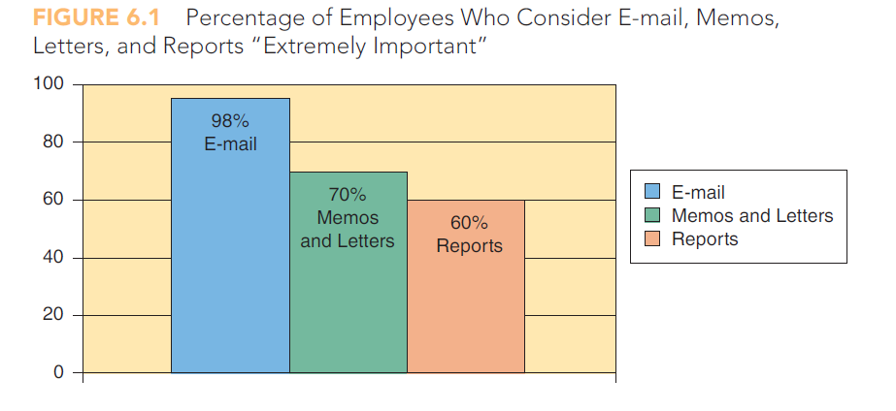

Slide 5
Characteristics | Memos | Letters | Email | IM/TM
Destination | Internal: correspondence written to colleagues within a company. | External: correspondence written outside the business. | Internal and external: correspondence written to friends and acquaintances, coworkers within a company, clients and vendors. | Internal and external: correspondence written to friends and acquaintances, coworkers within a company, and clients and vendors.
Format | Identification lines include “Date,” “To,” “From,” and “Subject.” The message follows | Includes letterhead address, date, reader’s address, salutation, text, complimentary close, and signatures. | Identification lines: To and Subject. Computer generated Date and From. Options include cc, forwarding email to others, and replying to readers. | No format.

Slide 6
Characteristics | Memos | Letters | Email | IM/TM
Audience | Generally high tech or low tech, mostly business colleagues. | Generally low-tech and lay readers, such as vendors, clients, stakeholders, and stockholders. | Multiple readers due to internal and external nature of email. | Multiple readers due to internal and external nature of IM and TM.
Topic | Generally topics related to internal corporate information; abbreviations and acronyms often allowed. | Generally topics related to vendor, client, stakeholder, and stockholder interests; abbreviations and acronyms are usually defined. | A wide range of diverse topics determined by the audience. | A wide range of diverse topics determined by the audience.

Slide 7
Characteristics | Memos | Letters | Email | IM/TM
Complexity and length of communication | Memos usually are limited to a page of text. If you need to write longer correspondence and develop a topic in more detail, you might consider using a different communication channel, such as a short report. | Letters usually are limited to a page of text, though you might write a two- or three-page report using letter format. If you need to develop a topic in greater detail, use longer channel such as formal report. | An effective email message is usually limited to viewable screen (no scrolling) or two screens. Email, generally, is not the best communication channel to use for complex information or long correspondence. If your topic demands more depth, use a report instead. | Text messages must be limited to 160 characters. The typical size of an instant message is around 200 characters (max. 400 characters).
Tone | Informal due to peer audience. | More formal due to audience and vendors, clients, stakeholders and stockholders. | Usually informal for friends, informal to coworkers, formal to management or external readers. | Very informal due to limits placed on size.

Slide 8
Characteristics | Memos | Letters | Email | IM/TM
Attachments or enclosures | Hard copy attachments can be stapled to the memo. Complimentary copies (cc) can be sent to other readers. | Additional information can be enclosed within envelope. Complimentary copies (cc) can be sent to other readers. | Computer word processing files, HTML files, Web links, PDF and RTF files or downloading graphics can be attached to email. Complimentary copies can be sent to other readers. | Attachments can be sent using IM. You can send photo attachments with TM. However, sending file attachments with TM is limited.
Delivery Time | Determined by a company’s in-house mail procedure. | Determined by the destination (within the city, state, or country). Letters could be delivered within three days but may take more than a week. | Often instantaneous, usually within minutes. Delays can be caused by system malfunctions or excessively large attachments. | Instantaneous.

Slide 9
Characteristics | Memos | Letters | Email | IM/TM
Security | If a company’s mail delivery system is reliable, the memo will be packed in the reader’s mailbox. Then, what the reader sees on the hard-copy page will be exactly what the writer wrote. Security depends on the ethics of coworkers and whether the memo was sent in an envelope. | The US postal service is very reliable. Once the reader opens the envelope, he or she sees exactly what was written. Privacy laws protect the letter’s content. | Email systems are not secure. Email can be tampered with, read by others, and sent to many people. Email stays within a company’s computer backup system and is the property of the company. Therefore, email is not private. | The same problems with email security exist with IM and TM.

Slide 10
Memos vs. Emails
Not all employees have access to computers or office spaces
All companies don’t have email, so they rely on hard-copy documentation like memos
Memos can be displayed on walls and can be signed as a means of acknowledgement by employees
Some information cannot be transmitted through email (ex: hard-copy cancelled cheques)
Emails are easily disregarded due to their sheer volume. Memos make an official statement

Slide 11
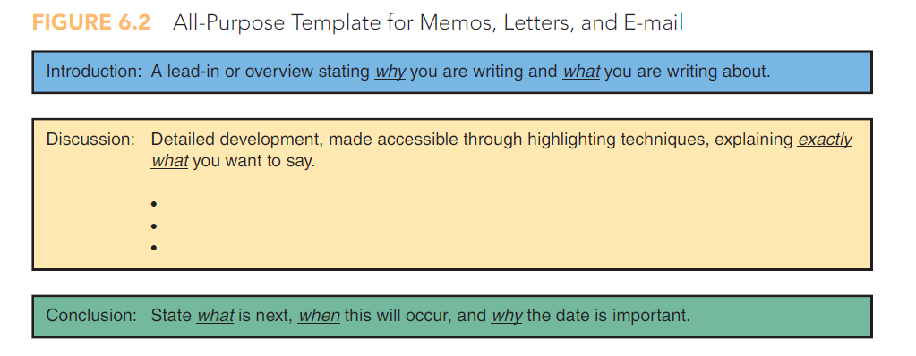

Slide 12

Memos

Slide 13
Memos
Memos are hard-copy correspondence written within your company.
Wide range of readers
Supervisors
Coworkers
Subordinates
Multiple combination of these audiences

Slide 14
Memos
Memos are frequently used; thus, very flexible.
Written for many different purposes:
Documentation
Confirmation
Procedures
Recommendation
Feasibility
Status
Directive (delegation of responsibilities)
Inquiry
Cover

Slide 15
Documentation: Examples
Expenses
Incidents/Accidents
Problems encountered
Hirings/Firings
Projected costs

Slide 16
Confirmation: Examples
Meeting agenda
Date/time
Location
Decisions to purchase/sell
Costs/Expenditures

Slide 17
Procedures: Examples
How to set up accounts
Operate new machinery
Use new software
Apply online for job opportunities through the company’s intranet

Slide 18
Recommendation: Examples
Fire or hire personnel
Reason to purchase new equipment
Merge with other companies
Contract with new providers/renew contracts

Slide 19
Feasibility: Examples
Studying the possibility of changes in the workplace
studying the possibility of changes in the workplace (practices,
procedures, locations, staffing, equipment, missions/visions)

Slide 20
Status: Examples
Daily, weekly, monthly, quarterly, biannual, yearly statements about where you, the department, or the company is regarding many topics (sales, staffing, travel, practices, procedures, or finances)

Slide 21
Directive (delegation of responsibilities): Examples
informing subordinates of their designated tasks.

Slide 22
Inquiry: Examples
asking questions about upcoming processes or procedures.

Slide 23
Cover: Examples
prefacing a proposal, long report, or other attachments.

Slide 24
Memos
Key components in drafting a memo
Memo identification lines
Conclusion
Audience Recognition
Introduction
Discussion
Appropriate memo style and tone

Slide 25
Subject Line
Summarizes the memo’s content.
Subject line = Topic (what) + Focus (what about what)
Do NOT make a one-word subject for memo

Slide 26
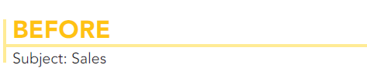


Slide 27
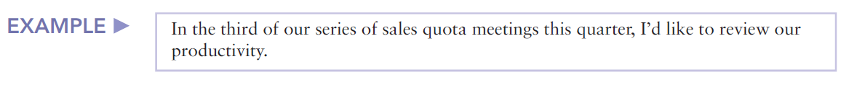
Introduction
Write one or two clear introductory sentences which tell your readers what topic you are writing about and why you are writing.

Slide 28
Discussion
Develop content specifically
Paragraphs are not necessarily effective as they do not enable ease of access
Make your text reader friendly by:
Itemizing
Using White space
Boldfacing
Creating headings
Inserting graphics

Slide 29

Discussion
Bullet list or chunk information
Develop content specifically
Paragraphs are not necessarily effective as they do not enable ease of access
Make your text reader friendly by:
Itemizing
Using White space
Boldfacing
Creating headings
Inserting graphics

Slide 30
Discussion
Use the space in your document creatively to add messages
Develop content specifically
Paragraphs are not necessarily effective as they do not enable ease of access
Make your text reader friendly by:
Itemizing
Using White space
Boldfacing
Creating headings
Inserting graphics

Slide 31
Discussion
Using highlighting techniques such as bold or italicized
Develop content specifically
Paragraphs are not necessarily effective as they do not enable ease of access
Make your text reader friendly by:
Itemizing
Using White space
Boldfacing
Creating headings
Inserting graphics

Slide 32
Discussion
Use heading to segment your content
Develop content specifically
Paragraphs are not necessarily effective as they do not enable ease of access
Make your text reader friendly by:
Itemizing
Using White space
Boldfacing
Creating headings
Inserting graphics

Slide 33
Discussion
Use visuals where required
Develop content specifically
Paragraphs are not necessarily effective as they do not enable ease of access
Make your text reader friendly by:
Itemizing
Using White space
Boldfacing
Creating headings
Inserting graphics

Slide 34
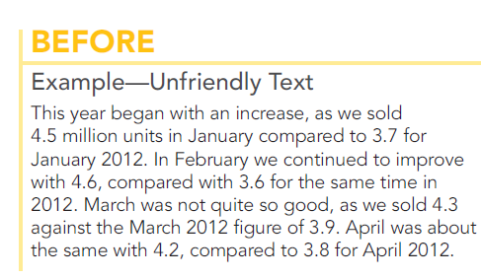
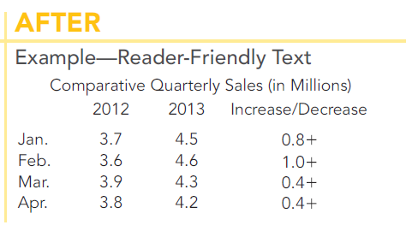

Slide 35
Conclusion
Conclude your memo with thanks and/or directive action
Pleasant conclusion can motivate your readers
A directive close tells your readers about call to action or what your plans are (dated action)

Slide 36
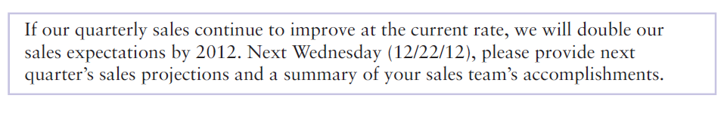

Slide 37
Audience Recognition
Memos have an in-house audience, so they are easier to address.
Usually, high tech or low tech
More acronyms and internal abbreviations

Slide 38
Audience Recognition
Memos have an in-house audience, so they are easier to address.
Usually one (single or plural) reader but CC (complimentary copy) to other readers
immediate supervisor (high tech)
His or her boss (low tech)

Slide 39
Style and Tone
Use simple words
Short sentences
Specific detail
Highlighting Techniques
Informal, friendly tone

Slide 40
Style and Tone
Audience determines tone
Directive tone to subordinates
Do not use a dictatorial tone
Treat subordinates respectfully

Slide 41
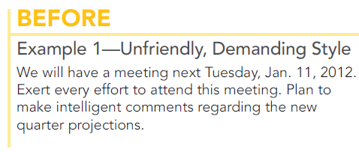
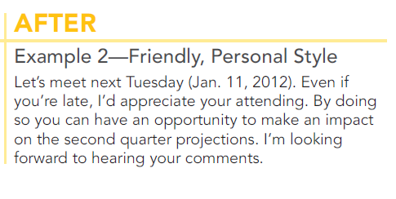

Slide 42
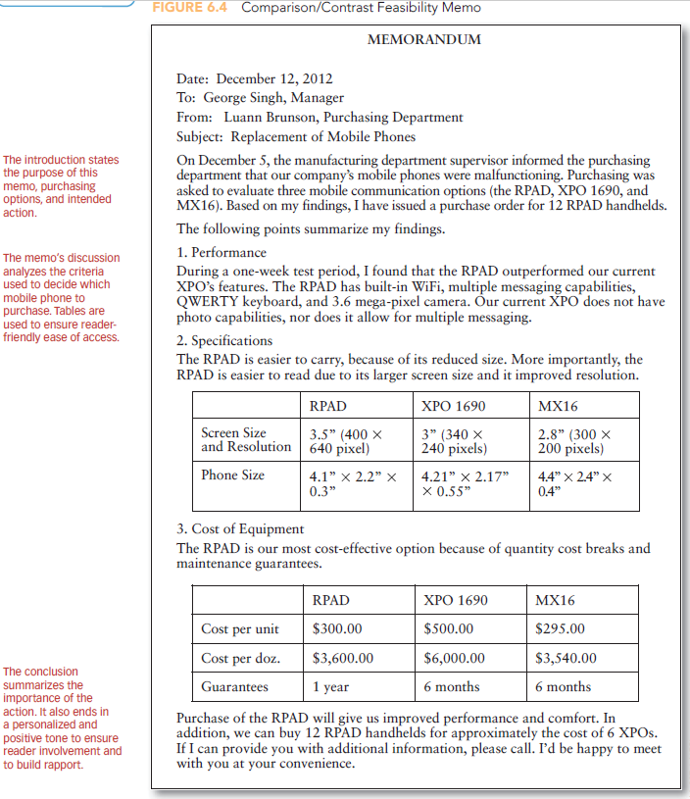

Slide 43
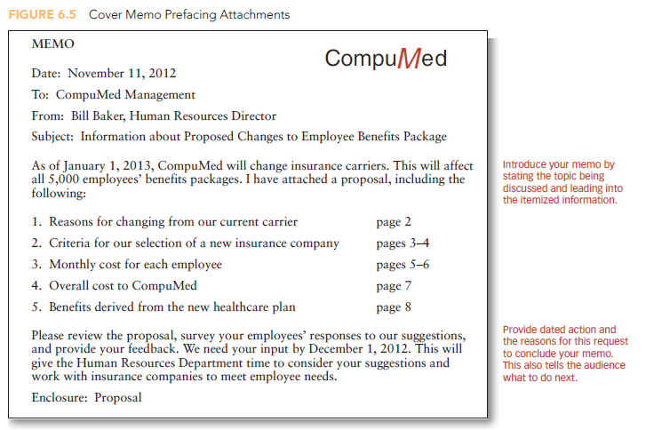

Slide 44
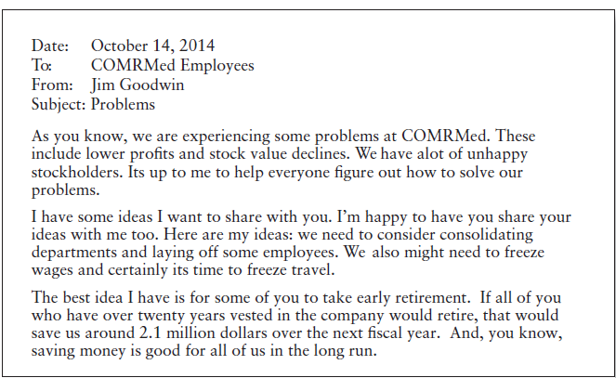
Activity: Rewrite the Memo
Identify the errors in this memo and propose solutions

Slide 45

Emails

Slide 46
Emails: Common Misconceptions Debunked
Email follows conventions of grammar and mechanics.
Business emails are formal communication so be careful
Emails are not suitable for resolving issues which require greater detail.
Emails are monitored by employers so using them for being sociable is not acceptable.

Slide 47
Emails
“Email culture” is taken up by many companies as a predominant mode of routine correspondence.
Emails are convenient
Time
Convenience
Cost
Documentation
Internal/External

Slide 48
Emails
“Email culture” is taken up by many companies as a predominant mode of routine correspondence.
Essential components of Email
Recognize your Audience
Provide and effective subject line
Keep your message brief
Organize your email message
Use highlighting techniques sparingly
Be careful when sending attachments
Practice netiquette
Identify yourself

Slide 49
Recognize your Audience
Factor in levels of knowledge
Factor in audience language (units, abbreviations/acronyms)
Factor in technology needs

Slide 50
Identify Yourself
Name, affiliation and title
Add it as a signature or a .sig file
Acts as your online business card

Slide 51
Provide an Effective Subject Line
Avoid uninformative subject lines
Some additional tips:
Start with information-bearing word(s)
Keep it short and sweet
State content
Summary of your message

Slide 52
Keep your Message Brief
Readers skim and scan so ensure ease of access
Apply the top of the screen test
Limit your message to one screen

Slide 53
Organize your Email Message
Introductory sentences to share what you are writing about
Clarify your points thoroughly in discussion
Inform the reader when a follow-up is required (dated)

Slide 54
Use Highlighting Techniques Sparingly
Boldface, italics, underlining, computer generated bullets and numbers, centering, font color highlighting and changes.
Some platforms don’t have these enhancements.
Limit highlighting to asterisks, numbers, double spacing and headings.

Slide 55
Additional considerations
Proofread your Email
Make hard copies for future reference
Be careful with attachments and their formats

Slide 56
Practice Netiquette
Be courteous
Be professional
Avoid abusive, angry emails (Flaming)

Slide 57


Slide 58
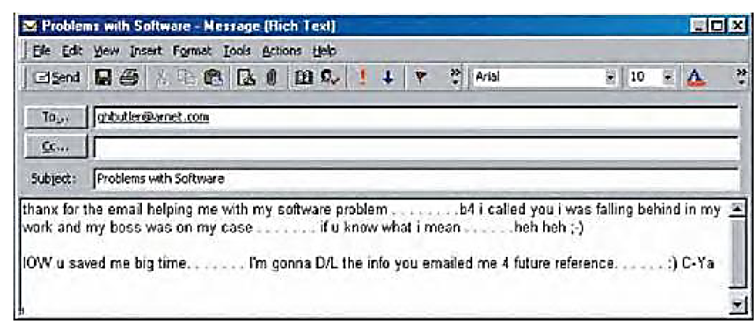
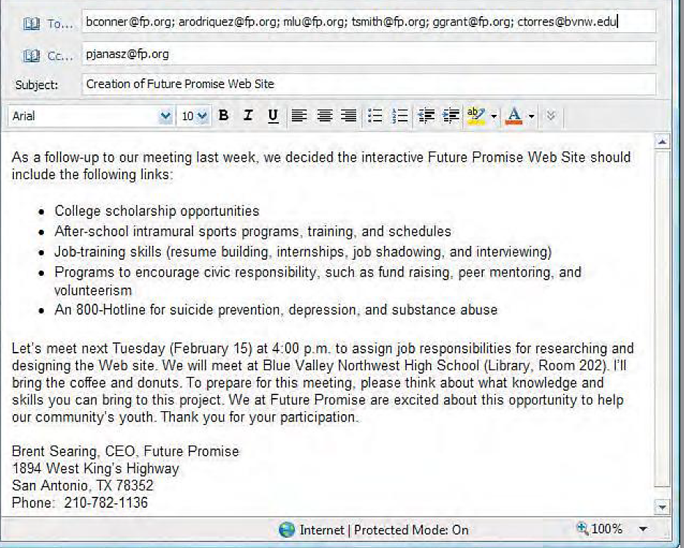

Slide 59

Instant Messages

Slide 60
Text Messages
Demand conciseness (160 characters)
Speedy and effective
Cost effective
Decrease intimidation factor
Facilitates documentation

Slide 61
Challenges of IM
Security issues
Lost productivity
Employee abuse
Distraction
Netiquette
Spim (Instant Message Spam)

Slide 62

Writing Positive Messages

Slide 63
Routine and Positive Messages
Use Direct approach
Stating your request upfront
Planning and justifying your request
Make a courteous close

Slide 64
Stating your Request Upfront
Pay attention to tone
Assume that the audience will comply
Be specific

Slide 65
Explaining and Justifying your Request
Justify the request or explain its importance
Ask the most important questions
Explain any potential benefits of responding
Break complex requests into individual questions

Slide 66
Request specific action with a courteous close
Express your gratitude
Include appropriate contact information
Clearly state any important deadlines (dated action)

Slide 67
Asking for information and action
Why you are making the request
What you want to know
Why it may be in your readers’ interests to help you

Slide 68
Starting with the Main Idea
Prepare your audience for details that follow
Make a clear and concise opening

Slide 69
Conclusion

